Slide 1
Understanding the
Physical Fitness Test (PFT)
Notes:
Good Evening Families!
Thank you for being here!
Today/tonight I’d like to talk to you about the testing your child will participate in related to their physical health and fitness called the Physical Fitness Test or PFT.
Let’s get started!

Slide 2


What:
Notes:
The PFT is the test that is used to measure the level of physical fitness and health of California students in grades 5, 7, and 9.
As many of you know, high levels of physical fitness have been shown to reduce the risk of several illnesses.
The test given to students in California is the FITNESSGRAM® developed by the Cooper Institute.

Slide 3

Why:
The primary goal to the FITNESSGRAM is to assess the physical fitness of students.
Notes:
You may be wondering why students need to take the PFT?
The PFT is one piece of information about your child’s physical health. In particular it provides a unique look at your child’s fitness.
The primary goal to the FITNESSGRAM is to assist in establishing lifetime habits of regular physical activity.
The PFT provides information that can by used by students to assess and plan personal fitness programs, by teachers to design the curriculum for physical education programs, and by parents and guardians to understand their children’s fitness level.

Slide 4

Who:
Notes:
By law, all school districts are required to administer the PFT each year to students in grades five, seven, and nine.
All students in these grades are required to take the PFT whether or not they are enrolled in a physical education (PE) class or participate in a block schedule.
Most of the fitness areas have two or three test options so all students, including those with special needs, have the chance to participate in the PFT.

Slide 5

How:
Notes:
Students may take the PFT over multiple days or it might be administered all at one time.
Each student is tested on the six areas shown on this slide.
I’m going to spend just a few minutes talking about the different options so you have a better understanding about what your child will be asked to do.
For aerobic capacity there are three test options:
One mile run
Walk test
PACER
For Abdominal Strength and endurance there is only one option, the Curl Up.
For Upper Body Strength and Endurance there are three test options:
Push-Up
Modified Pull Up
Flexed Arm Hang
For Trunk Extensor Strength and Flexibility there is only one option, the Trunk Lift.
For Body Composition there are three test options:
Skinfold Measurement
Bio-electric Impedance analyzer
Body Mass Index
For Flexibility there are two test options:
Back-Saver sit and reach
Shoulder stretch
Your child’s PE teacher is the best person to reach if you have specific questions about the options that will be used here at [insert school name here].

Slide 6

When:
February 1 – May 31
Notes:
The PFT is given every year throughout the state.
The test may be given anytime between February 1 and May 11.

Slide 7
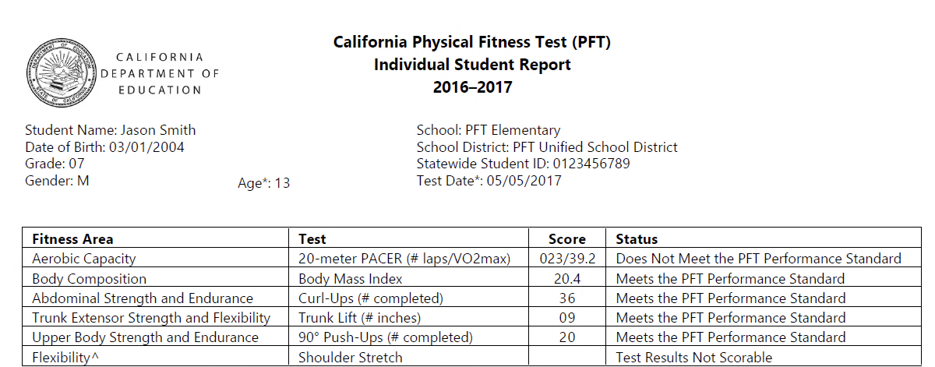
Scores:
Notes:
This slide shows a sample of the report you will receive after your child takes the PFT.
Students receive scores in each of the six areas.
The goal is that each student scores in the Healthy Fitness Zone in all six areas.
A score of Needs Improvement in a fitness area means that student’s health would benefit from more activity in that fitness area.

Slide 8

Ask your child’s teacher:
Ask your child’s teacher:
  In what areas is my child doing well?
  In what areas might my child need some extra support?
  How can I help support my child at home?
  How are you supporting my child at school?
Notes:
Additionally, you can help support your child’s success.
First, and foremost, talk to your child about what activity they are getting every day. Make sure you give them opportunities to be active either in structured or unstructured play.
Your child’s teacher is your #1 resource. The best time to contact your child’s teacher is either before or after school. Ask your child’s teacher about how they like to be contacted – either by phone or via e-mail.
When you talk to your child’s teacher ask them specific questions about your child, ask:
Where is my child doing well?
Where might my child need some extra support?
Who will provide that extra support?
How can I and other family members help at home?
Those are just a few examples of how to start a conversation with your child’s teacher.

Slide 9

Help Your Child Succeed
Talk with your child about the test.
60 minutes of activity every day.
Get a good night’s sleep and eat a nutritious breakfast before testing.
Help your child plan fitness activities to meet their goals.
Notes:
Additionally, here are a few other ways that you can help your child be successful:
Talk about the PFT with your child. Make sure they feel supported and not anxious.
Tell your child that you and the teacher have high expectations and are there to help, every step of the way.
Help make sure your child engages in 60 minutes of activity every day.
Make sure your child gets a good night’s sleep and a nutritious breakfast before testing.
Look at your child’s PFT results to help them plan fitness activities to meet their goals.

Slide 10
Learn More:
Review the Parent Guide to Understanding
  Available in seven languages
  https://www.cde.ca.gov/ta/tg/ca/parentguidetounderstand.asp
Notes:
The California Department of Education has developed a series called the Parent Guide to Understanding. These guides are simple overviews that answer the critical questions of what, why, who, how, and when about each assessment.
You can find those on the Web site listed on this slide.

Slide 11

Questions
Notes:
Please contact your child’s PE Teacher.

